Slide 1
02/03/2022
Title: Index 3rd law
Aims:
Know and be able to use the third law of indices.
Plan:
Daily review:
Index Law #1, #2.
Index Law #3

Slide 2
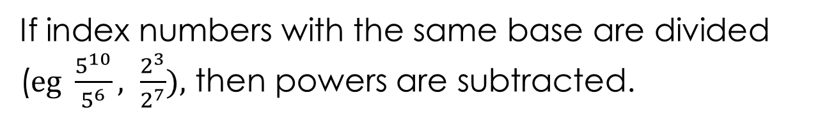
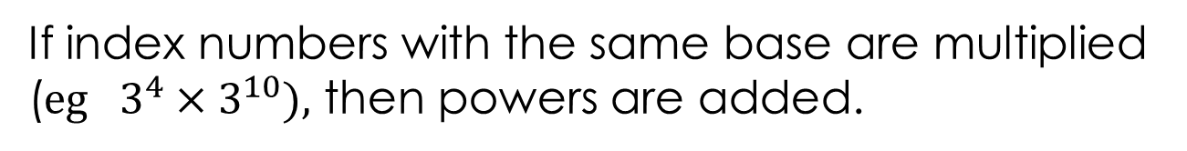
Daily review
If index numbers with the same base are multiplied ($eg 3^{4}×3^{10}),$ then powers are added.
If index numbers with the same base are divided ($eg \frac{5^{10}}{5^{6}}, \frac{2^{3}}{2^{7}}),$ then powers are subtracted.
But which way?

Slide 3

Daily review: white-boards
Simplify each of the following
$\frac{5^{8}}{5^{3}}$
$3^{6}×3^{2}×3^{4}$
$\frac{2^{8}}{2^{10}}$
$7^{2}×7^{5}×7^{−4}$
$\frac{2^{8}×2^{5}}{2^{10}}$
$5^{3}×5^{−5}×5^{2}$

Slide 4
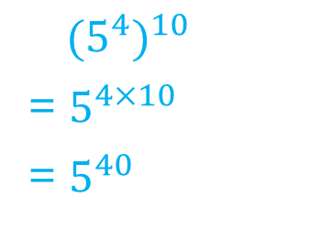
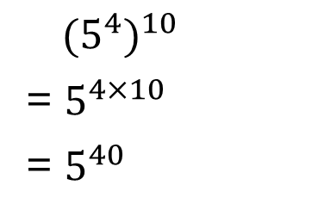
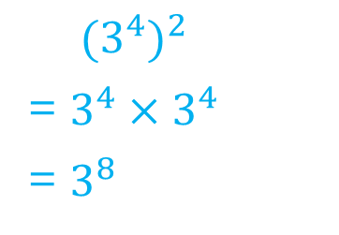
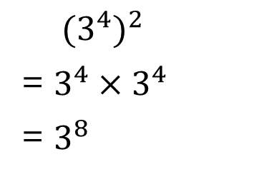
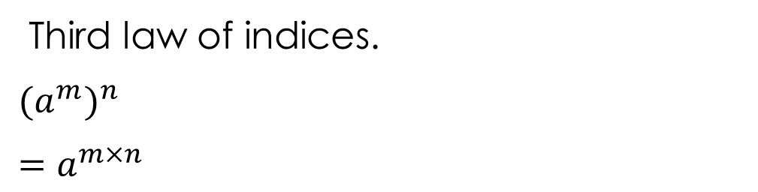
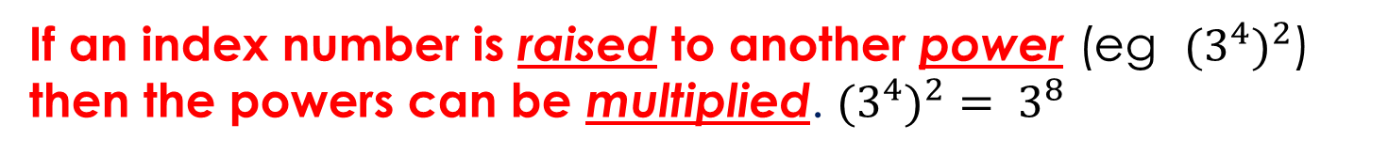
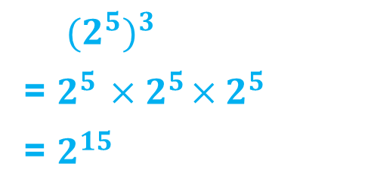
Exercise books: Notes
Simplifying expressions using indices - powers.
${{(3}^{4})}^{2}$
= $3^{4}{ ×3}^{4}$
= $3^{8}$
${{(3}^{4})}^{2}$
= $3^{4}{ ×3}^{4}$
= $3^{8}$
$({2^{5})}^{3}$
= $2^{5}{ ×2}^{5}×2^{5}$
= $2^{15}$
${{(5}^{4})}^{10}$
= $5^{4×10}$
= $5^{40}$
${{(5}^{4})}^{10}$
= $5^{4×10}$
= $5^{40}$
If an index number is raised to another power (eg ${{(3}^{4})}^{2}$) then the powers can be multiplied. ${{(3}^{4})}^{2}= 3^{8}$
Third law of indices.
${{(a}^{m})}^{n}$
$=a^{m×n}$

Slide 5
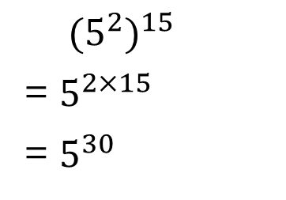
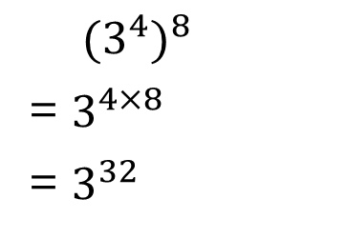


exercise books: I do, we do
Simplifying expressions using indices - powers.
${{(3}^{4})}^{8}$
= $3^{4×8}$
= $3^{32}$
$({5^{2})}^{15}$
= $5^{2×15}$
= $5^{30}$
$({2^{5})}^{−3}$
= $2^{5×(−3)}$
= $2^{−15}$
= $\frac{1}{2^{15}}$
$({2^{5})}^{0}$
= $2^{5×0}$
= $2^{0}$
= 1

Slide 6

exercise books: You do
Simplify.
${{(3}^{6})}^{3}$
${{(7}^{5})}^{4}$
${{(5}^{10})}^{2}$
${{(3}^{4})}^{−2}$
${{(2}^{3})}^{5}×$ ${{(2}^{4})}^{3}$

Slide 7
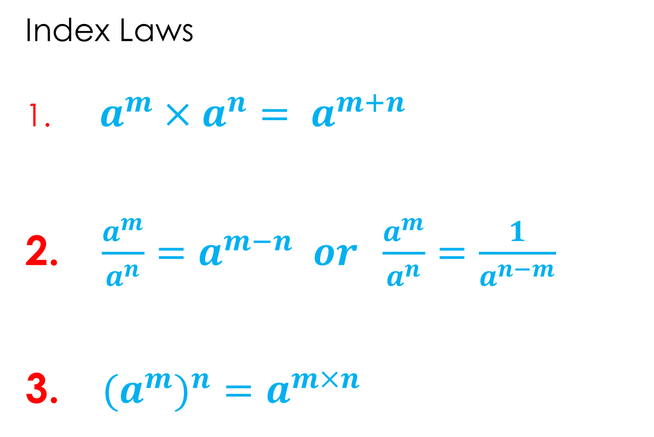
Copy into exercise book
Start our notes page
Index Laws
$a^{m}×a^{n}= a^{m+n}$
$\frac{a^{m}}{a^{n}}=a^{m−n} or \frac{a^{m}}{a^{n}}=\frac{1}{a^{n−m}}$
${{(a}^{m})}^{n}=a^{m×n}$

Slide 8
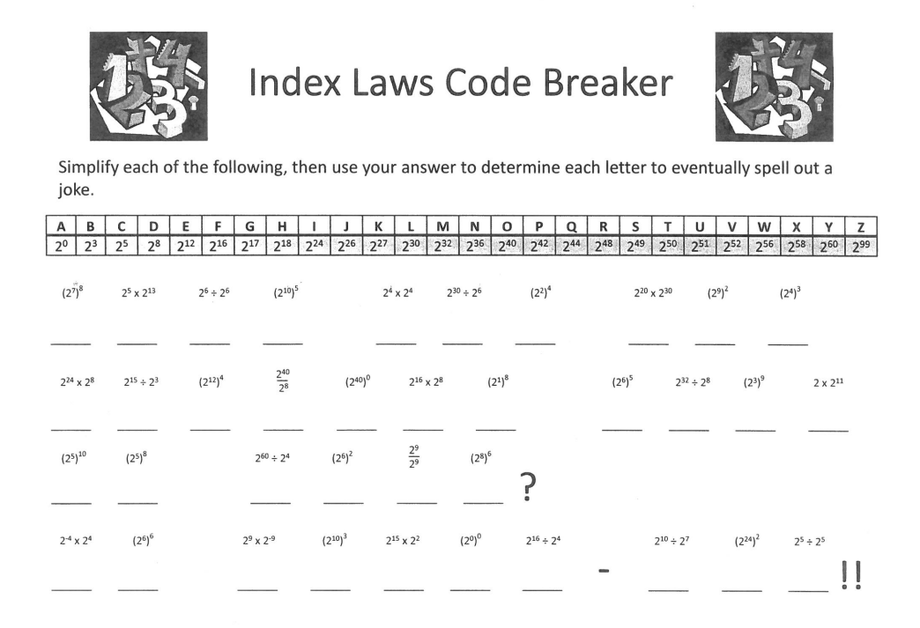
Complete answers on worksheet.

